Slide 1
HOTEL LOT
BANDSTAND PROJECT
2018
A COMMUNITY PROJECT
IN COOPERATION WITH
TOWN OF DEERING SELECTMEN
THE DEERING HIGHWAY DEPARTMENT
THE TOWN COMMON COMMITTEE
COMMUNITY VOLUNTEERS

Slide 2
In early 2018, the formal idea of a community built bandstand was pitched to Selectmen by the Town Common Committee.
The plan was presented after a year and half of study that gleaned public support based on several community surveys and outreach.
At the Town Hall, visual aids were put on display months in advance describing the project.

Slide 3
At their March 2018 Town Meeting, Deering voters approved funds for the community project.
Shortly thereafter, in late May, a group of community volunteers and the Deering Highway Crew began working on the project.

Slide 4
Phase One
Site Work
Begins

Slide 5
Selecting the Granite...
In early May, two community volunteers, Bob Compton and Bill Demotta, met with Road Agent Brian Houghton, Backhoe operator Mark Poland, and Highway crew member Darren Labierre at the Town Gravel Pit and began selecting the granite slabs for use as the foundation of the structure as well as for landscape features.
It took many trips over several days to truck the granite pieces from the pit to the Hotel Lot.

Slide 6
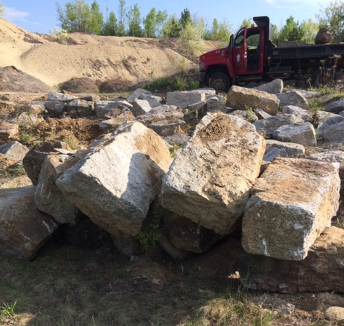
Over 65 pieces of granite were used.

Slide 7
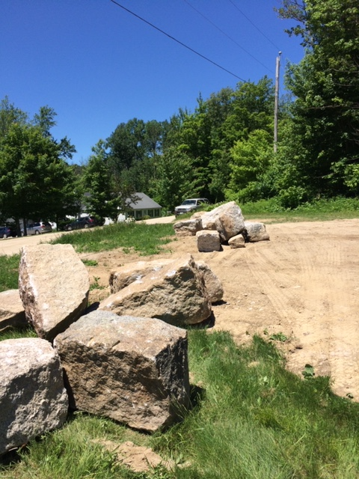

Slide 8
GROUNDBREAKING
The foundation hole was dug in a few short hours.
Crushed Stone and drainage pipe were laid under the granite foundation pieces...

Slide 9
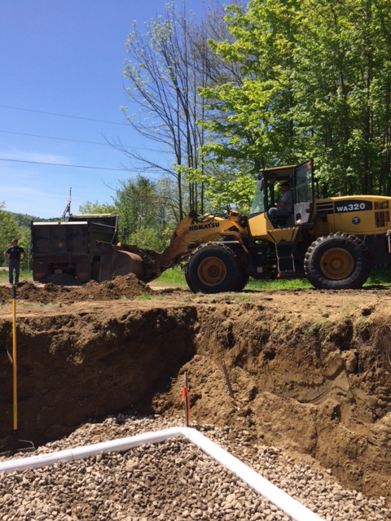

Slide 10
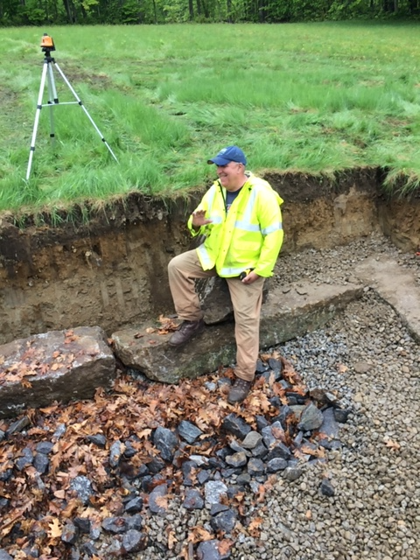

Slide 11
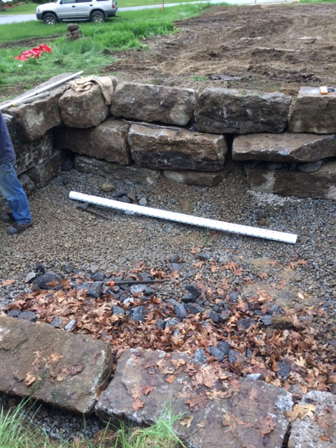

Slide 12
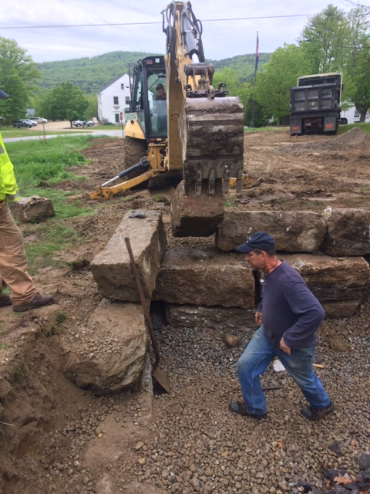
Mark operated the backhoe to set each granite foundation piece in place.
Here, Darren helps tweak one of 36 granite pieces that made up the faux foundation.

Slide 13
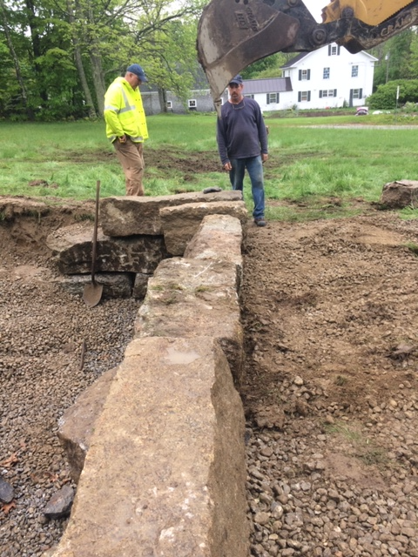

Slide 14
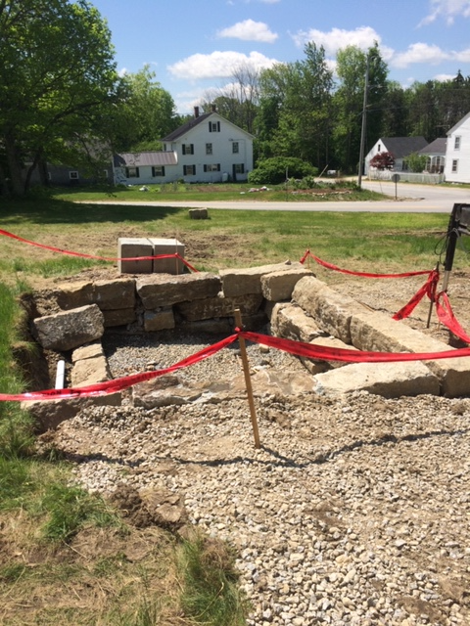

Slide 15
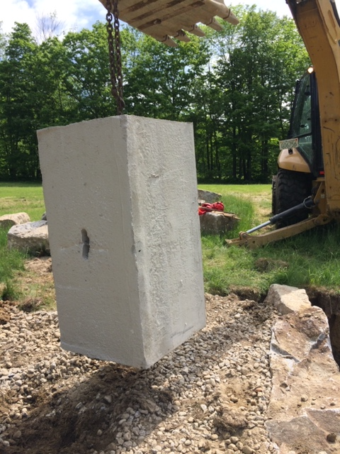
The completed bandstand appears to sit on the granite foundation.
However, the structure is actually supported by two stout girder beams that are attached to four 2’x2’x4’ 1-ton concrete waste blocks that were hidden inside the granite foundation.

Slide 16
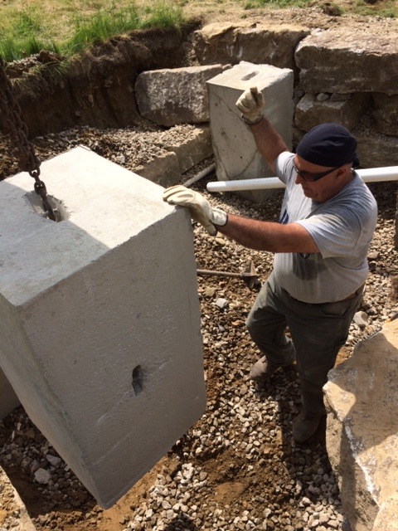
Bill Demotta was one of the stalwart volunteers who donated much time and effort.
In the photo, Bill helps set one of the concrete blocks.

Slide 17
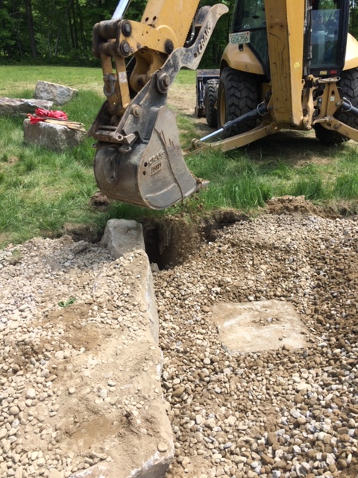
The foundation cavity was backfilled with crushed stone - keeping just the tops of the waste blocks exposed for the girder beams to be attached to.

Slide 18
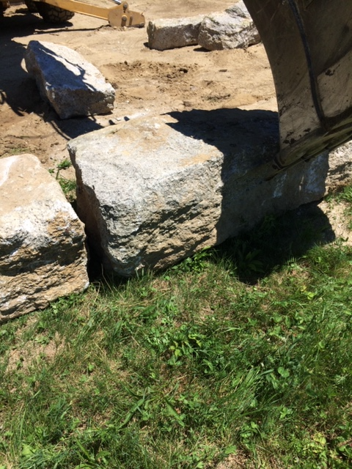
Mark used the backhoe to set many granite pieces around the site for utility and aesthetic effect.

Slide 19
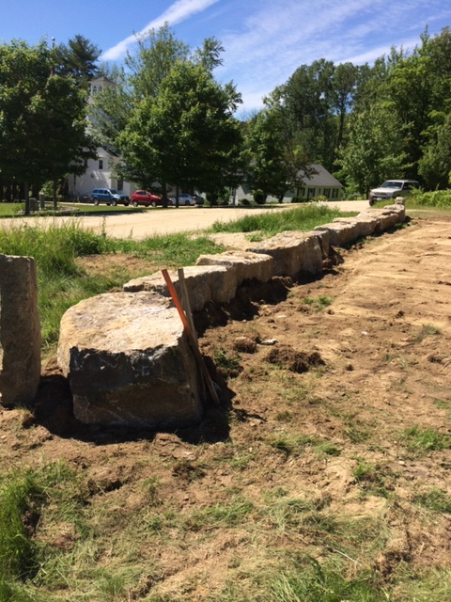
At left, a row of granite pieces serve as a safety barrier near a roadside ditch as well as a place for sitting and taking in the view.

Slide 20
Once the drainage and foundation elements were in place, the Road crew added crushed stone under the future eave drip lines, and then graded the entire area around the immediate site.

Slide 21
Phase Two
Construction

Slide 22
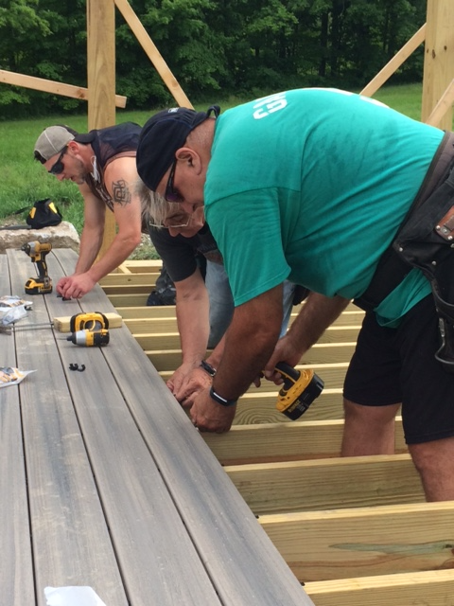
Construction brought in more helping hands to build the floor frame, set the 6”x6” posts and beams, and install the PVC decking with hidden fasteners.
This was accomplished over the course of four days.

Slide 23
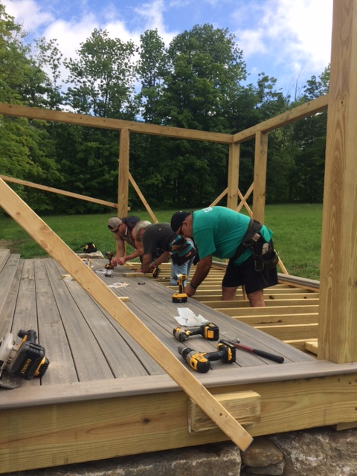

Slide 24
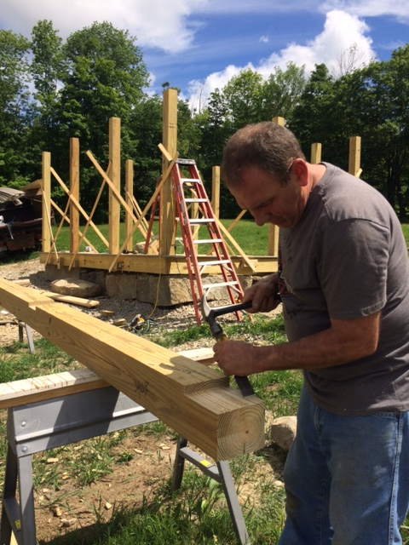
Tom Cummings, a member of the Town Common Committee and a regular volunteer throughout the project, puts the finishing touches on beam notches that will receive the posts to prevent twisting.
In the photo, note how the structure appears to be sitting on an old granite foundation.

Slide 25
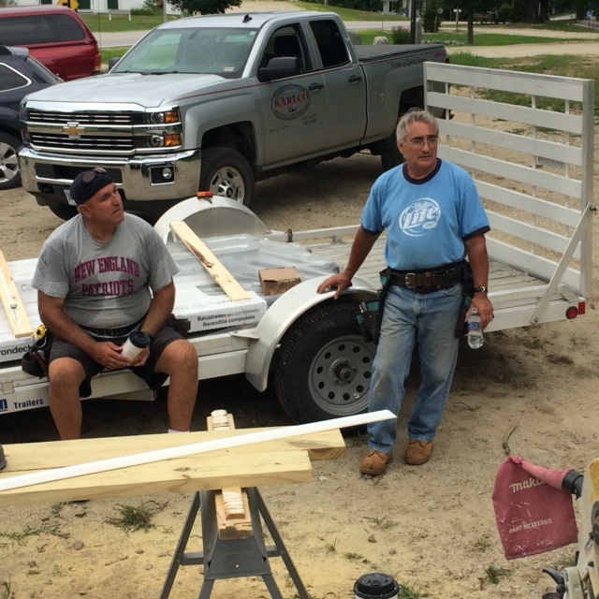
There were some brutally hot days on the site
which did not deter these volunteers...

Slide 26
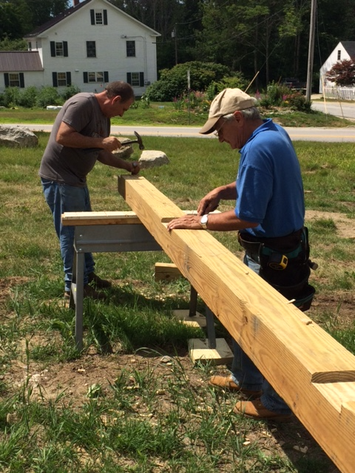
Two Toms, (Cavanaugh and Cummings) wield razor sharp chisels to achieve a neat surface and perfect inside corners of the Beam notches.

Slide 27
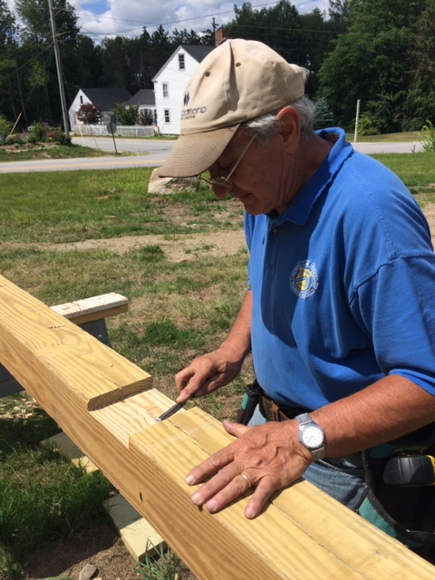

Slide 28
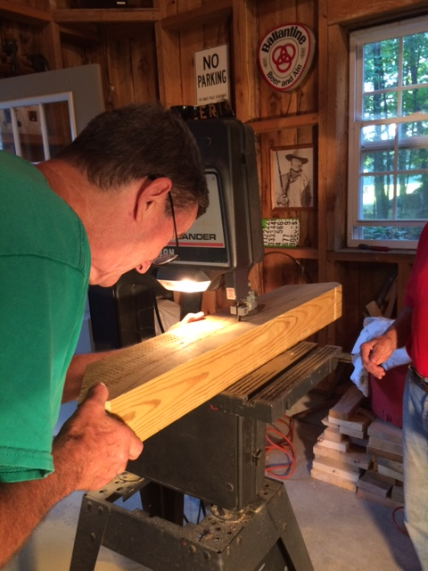
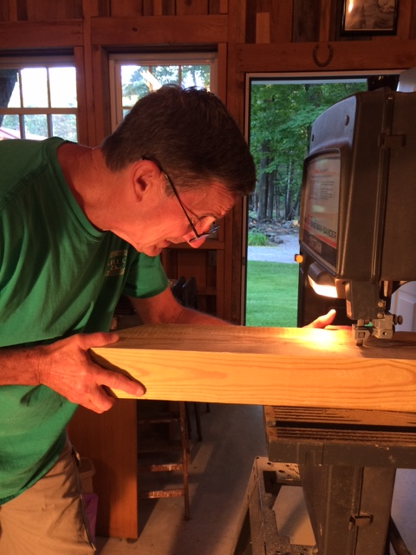
Karl Bearor cut the curved corner braces out of 4x6’s using Tom Cavanaugh’s old band saw (inherited from Bob Garland).
Despite a saw blade that was none too sharp, Karl muscled out eight very nice braces.

Slide 29
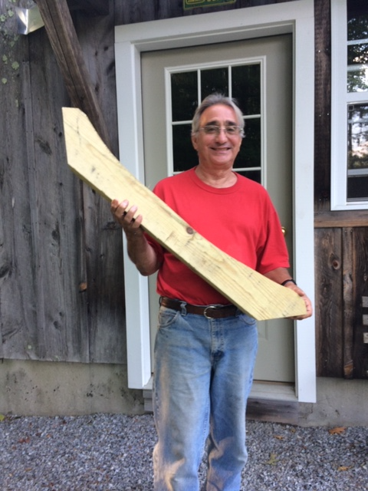

Slide 30
The posts and beams and braces were connected with structural screws and then shrouded with white Versatex (plastic wood) that created a clean, zero maintenance durable finish.
Next, it was time to install the handrail system.

Slide 31
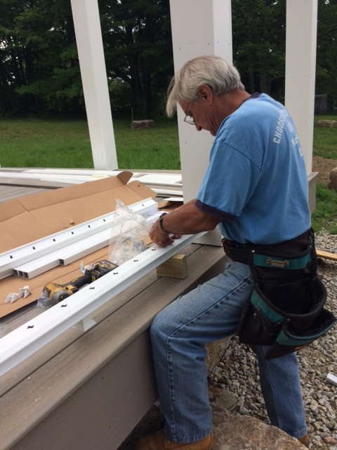
Tom Cavanaugh got very good at installing the pvc handrail system.
Tom painstakingly cut and installed the many small trim pieces around the post bases.

Slide 32
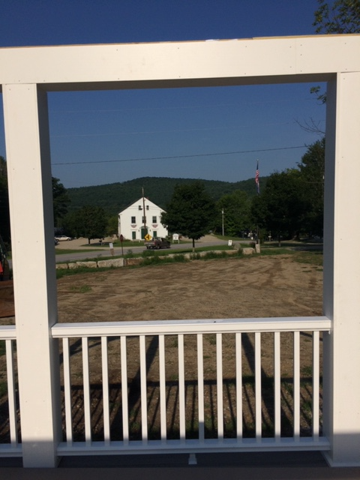
The view from the structure of the Historic Deering Town Hall and the Clark Poling summit on Wolf Hill.

Slide 33
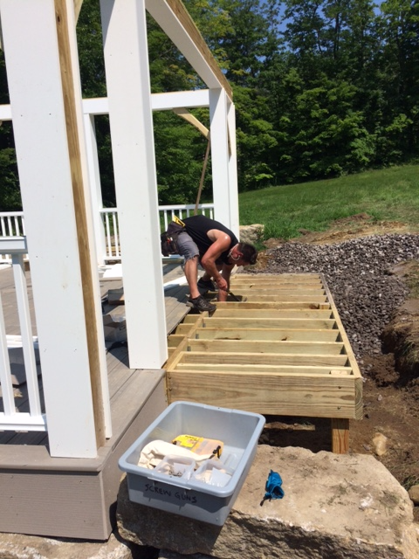
Cody Dickinson frames the access ramp.

Slide 34
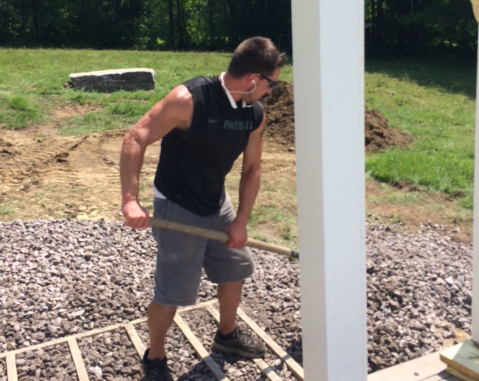
Once constructed, the area around the ramp was filled in with crushed stone for easier access.

Slide 35
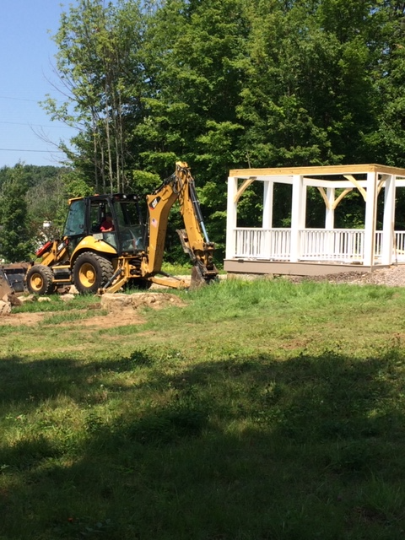

Slide 36
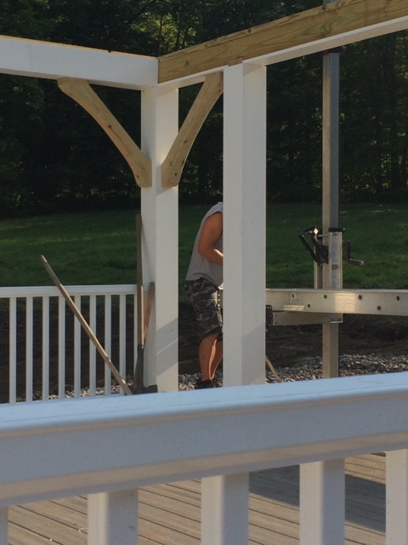

Slide 37
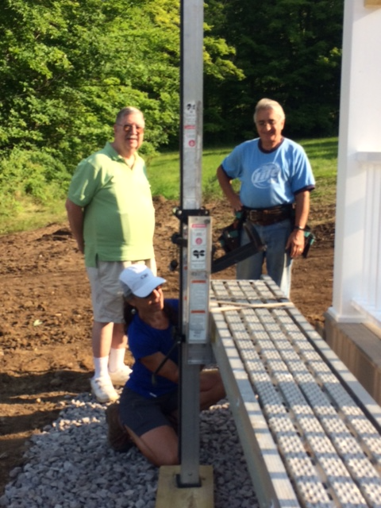
A. Ray Petty, a member of the Town Common Committee, was a regular visitor to the site to inspect progress and offer moral support. Ray also dug into his own pocket to donate toward the electrical phase.

Slide 38
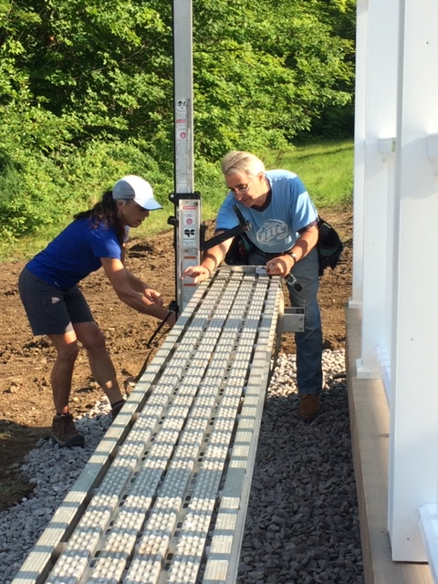
Safety First...
Here Kristine Dickinson and Tom Cavanaugh securely lash a plank to the staging pole.
Each volunteer who worked on the structure signed a release waiver.
There were zero injuries.

Slide 39
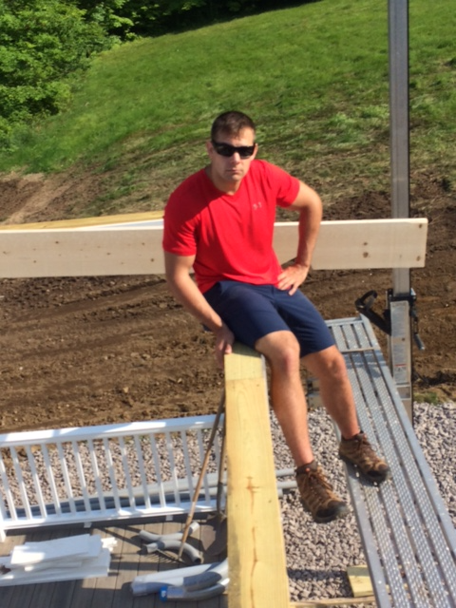
Tom Cavanaugh’s nephew,
Ian Bernett, stopped by one morning to lend a hand during the raising of the first set of rafters.

Slide 40
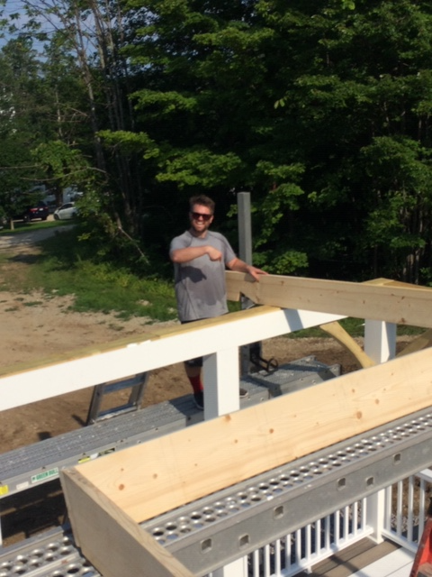
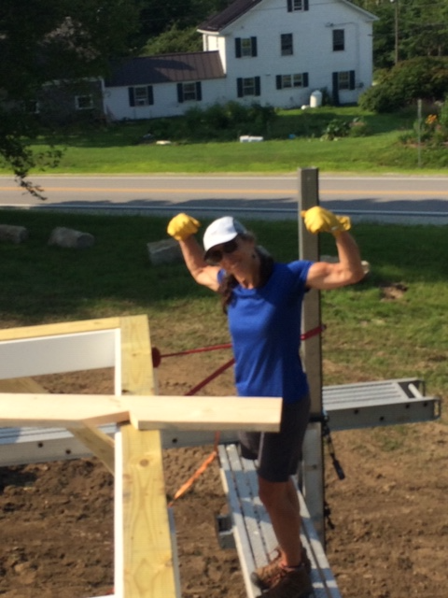
Connor Compton and Kristine Dickinson hefted some straight rafters.

Slide 41
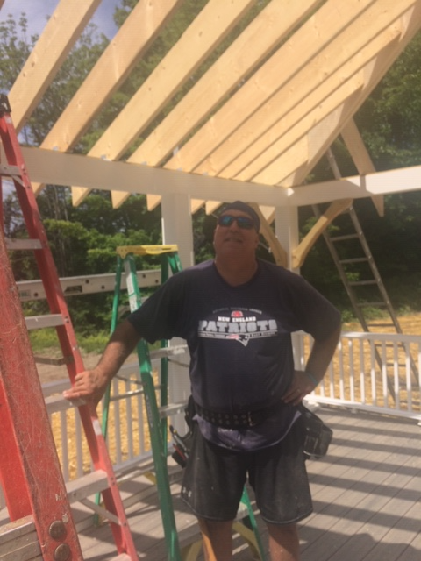

Slide 42
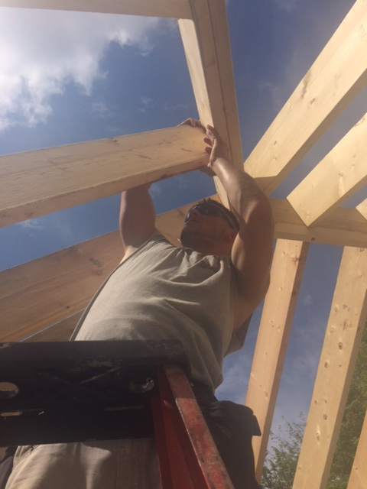
Cody Dickinson helps fit one of the many hip- jack rafters on the structure.
Note, the doubled hip rafter that was treated as a beam - required by code enforcement officer Mike Borden.

Slide 43
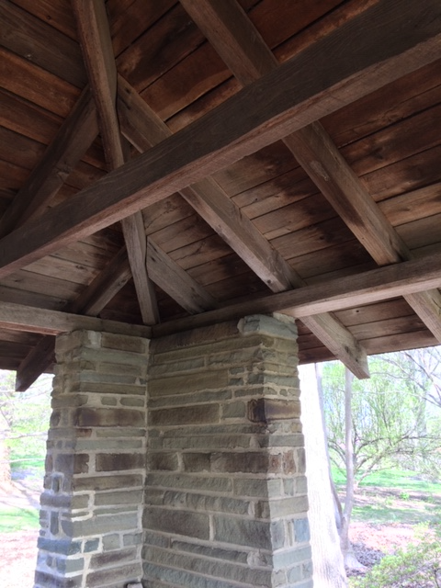
The bandstand roof design was modeled after a century-old structure that is located at the United States National Arboretum in Washington D.C..

Slide 44
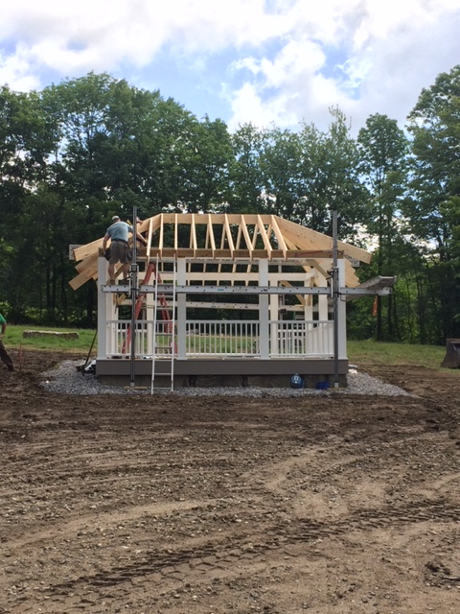

Slide 45
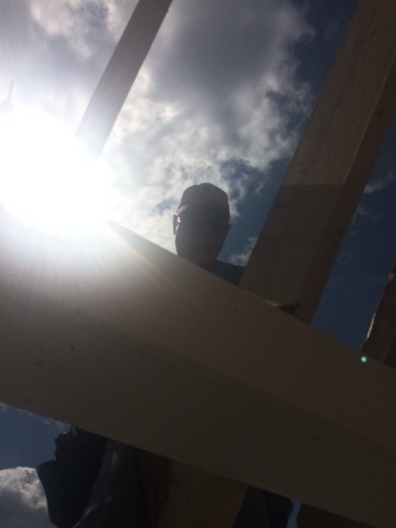

Slide 46
The electrical components were installed by Steve Gallagher of Abracadabra Electric. Steve installed a 200-amp meter socket and disconnect near the pole and a 200-amp weather proof panel at the structure.
The Highway boys dug the electrical trench. Many hands pulled the wires through 100 feet of buried conduit from the meter box to the panel.
The panel at the bandstand will be enclosed in a locked cabinet.

Slide 47
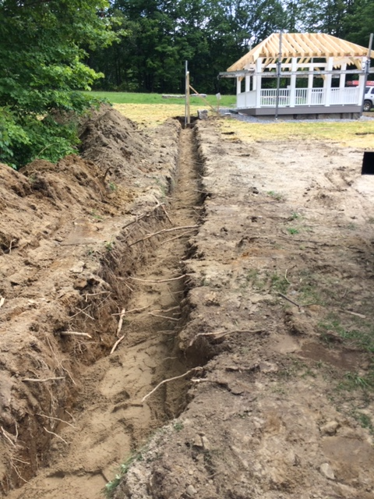

Slide 48
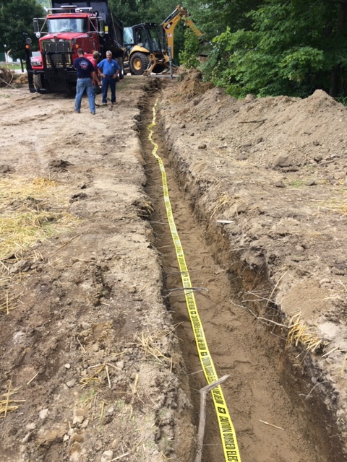

Slide 49
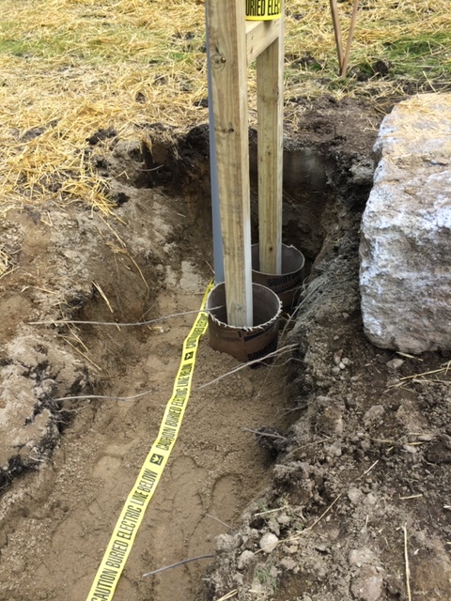

Slide 50
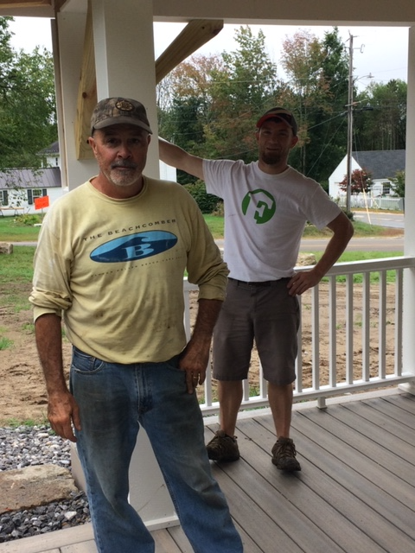
Local carpenters Dennis Sawyer and Jared Fournier were on hand the final day to help with installation of the asphalt roof shingles.

Slide 51
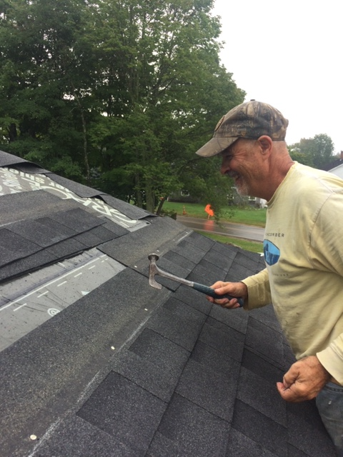

Slide 52
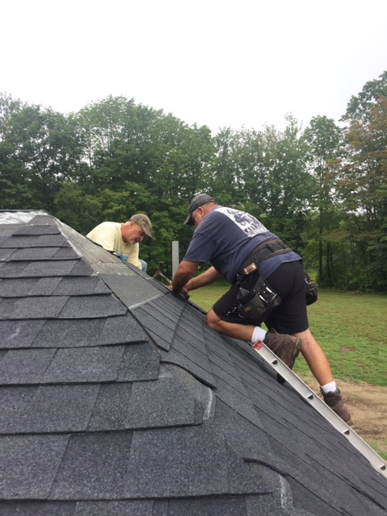

Slide 53
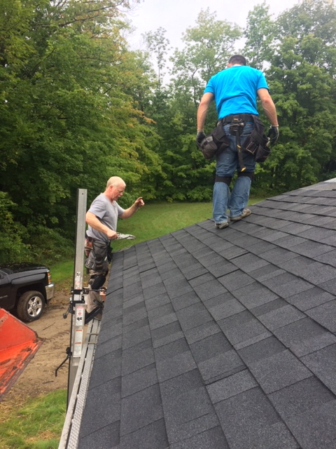
Bob Compton snips some shingles during the final roofing phase.

Slide 54
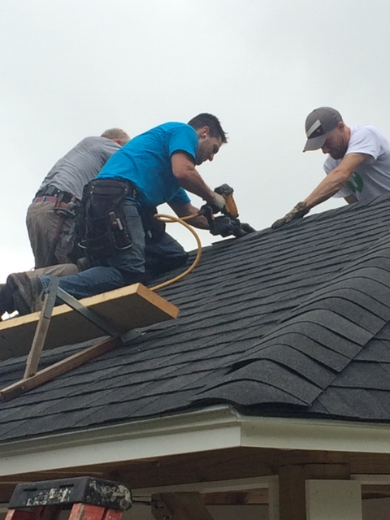

Slide 55
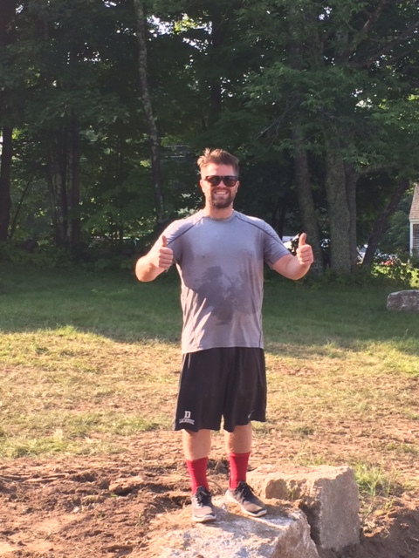
After countless hours of volunteer labor, through oppressive heat and rainy days. Under the watchful eyes of the community...
our citizen crew shook hands all around and gave this project a big
Thumbs up!

Slide 56
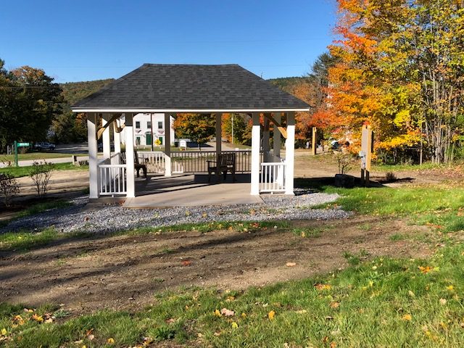

Slide 57
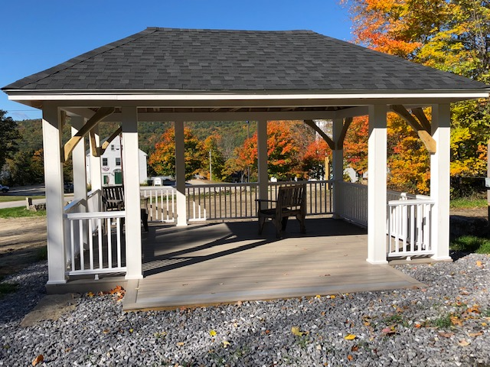

Slide 58
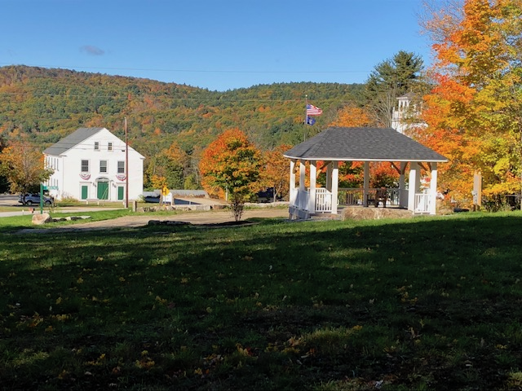

Slide 60
We thank the following core group of volunteers for their contribution.
Tom Cavanaugh
Bob Compton, Town Common Committee
Tom Cummings, Town Common Committee
Bill Demotta
Cody Dickinson
A HEARTY THANKS TO:
Karl Bearor
David Bearor
Ian Bernett
Connor Compton
Kristine Dickinson
Jared Fournier
Chuck Gaides
Aaron Gill, Town Common Committee Selectman’s Rep.
Darrell Harvey
Ralph LaChance, Town Common Committee
Ray Petty, Town Common Committee
Travis Putnam
Dennis Sawyer
Bryan Terry, Town Common Committee
A SPECIAL THANK YOU TO THE MEMBERS OF THE DEERING HIGHWAY DEPARTMENT
Brian, Mark, Darren, Alfred

