Slide 1
Report of the Town Common Committee
Presented to the Selectmen of Deering, NH
December 2017

Slide 2
Committee Members:
Bob Compton- Chair
Aaron Gill- Selectman’s Rep.
Bryan Terry- Deering Community Church Rep.
Tom Cummings- Year round resident
Ray Petty-Part time resident
Ralph Lachance- Year round resident

Slide 3
In May of 2016 Town of Deering Selectmen appointed a “Town Common and Hotel Lot Committee” and asked the group to “Develop a community usage/development plan for the Hotel Lot and a Master Plan for the Town Common.”
An expendable trust of $6000 had recently been approved by voters at March 2016 Town Meeting to assist the committee with planning expenses.
Furthermore, the committee was asked to report to the Selectmen upon achieving any plan that would require a warrant article to request money from voters “at the soonest Town Meeting”.

Slide 4
The Committee had their first meeting on May 25, 2016 and began to formulate a Vision Statement:
“Incorporate a multi-use design that includes as many persons in the community as possible.
Integrate existing natural features and resources to the extent possible in all designs and improvements.
Recognize and develop continuity between all town owned parcels and historic buildings in the Town Center
Acknowledge and celebrate the value of all existing historical landmarks and structures.”

Slide 5
For the first months, the Committee compiled many ideas (within reason) toward development of the Hotel Lot that would achieve the community vision. In June 2017, the group began to discuss the proposals in detail.
By September 2017, the Committee had a reasonable list of development ideas to hone in on to present to Selectmen for consideration.
NOTE: The Committee’s work is not done. However, since we did come to a consensus with regard to a potential structure that could be built on the Hotel Lot and, one that could be brought up for consideration at March 2018 Town Meeting, we are presenting this report to Selectmen as an update of our work.

Slide 6
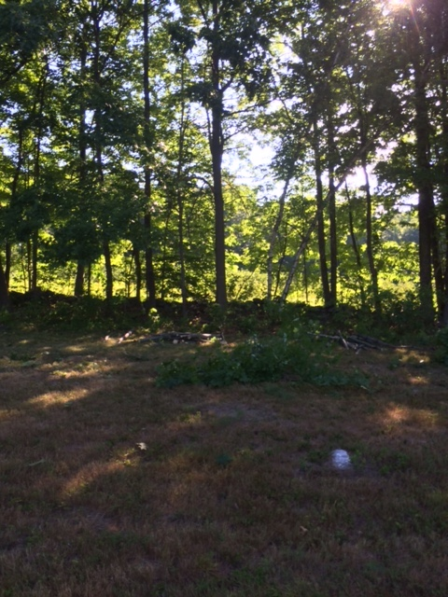
On one late summer Saturday morning the committee rolled up their sleeves and did some stone wall brush cutting at the Hotel Lot.

Slide 7
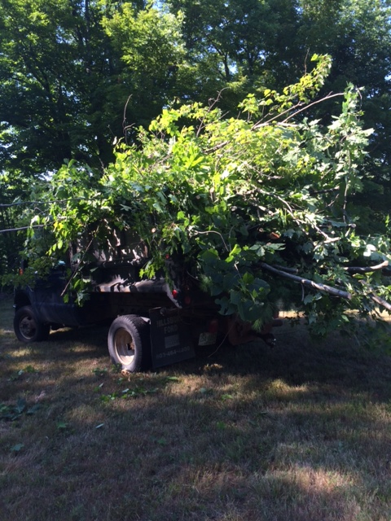

Slide 8
The 2016 Town Barbecue Hotel Lot survey
garnered 35 responses...
The majority wanted to maintain Deering’s “rural character” regardless of any changes that might be made
60% were in favor of some kind of multi-use structure for community events.
15% wanted the Hotel Lot to remain unchanged.
Some suggested more plantings (like apple trees) while an even number said keep plantings to a minimum.
20% asked for more benches to sit on.
20% suggested some kind of kid’s playground
Other ideas were: A stone patio with remembrance pavers, establishing the Hotel Lot as a starting point for hiking trails.
A few were specific about having more events like the barbecue at the site.

Slide 9
The Committee relocated the Sandwich Board to inside the Town Hall during all of 2017.
Comments trickled in:
Those in favor of any improvements on the Hotel Lot stressed keeping our rural character intact.
A few respondents were against any kind of development that would raise taxes.
At the Town-wide barbecue of Labor Day weekend 2017, another display was presented to townspeople showing several views of a proposed Bandstand. The display cordoned off two areas on the Hotel Lot for possible siting of the structure. Both sites were favored. The committee chose the higher site because the view is better.

Slide 10
The following suggestions represent improvements that could be made to the Hotel Lot with only modest expenditures.
Some of these ideas are presented in a form so that they can be expanded or enhanced in the future.

Slide 11
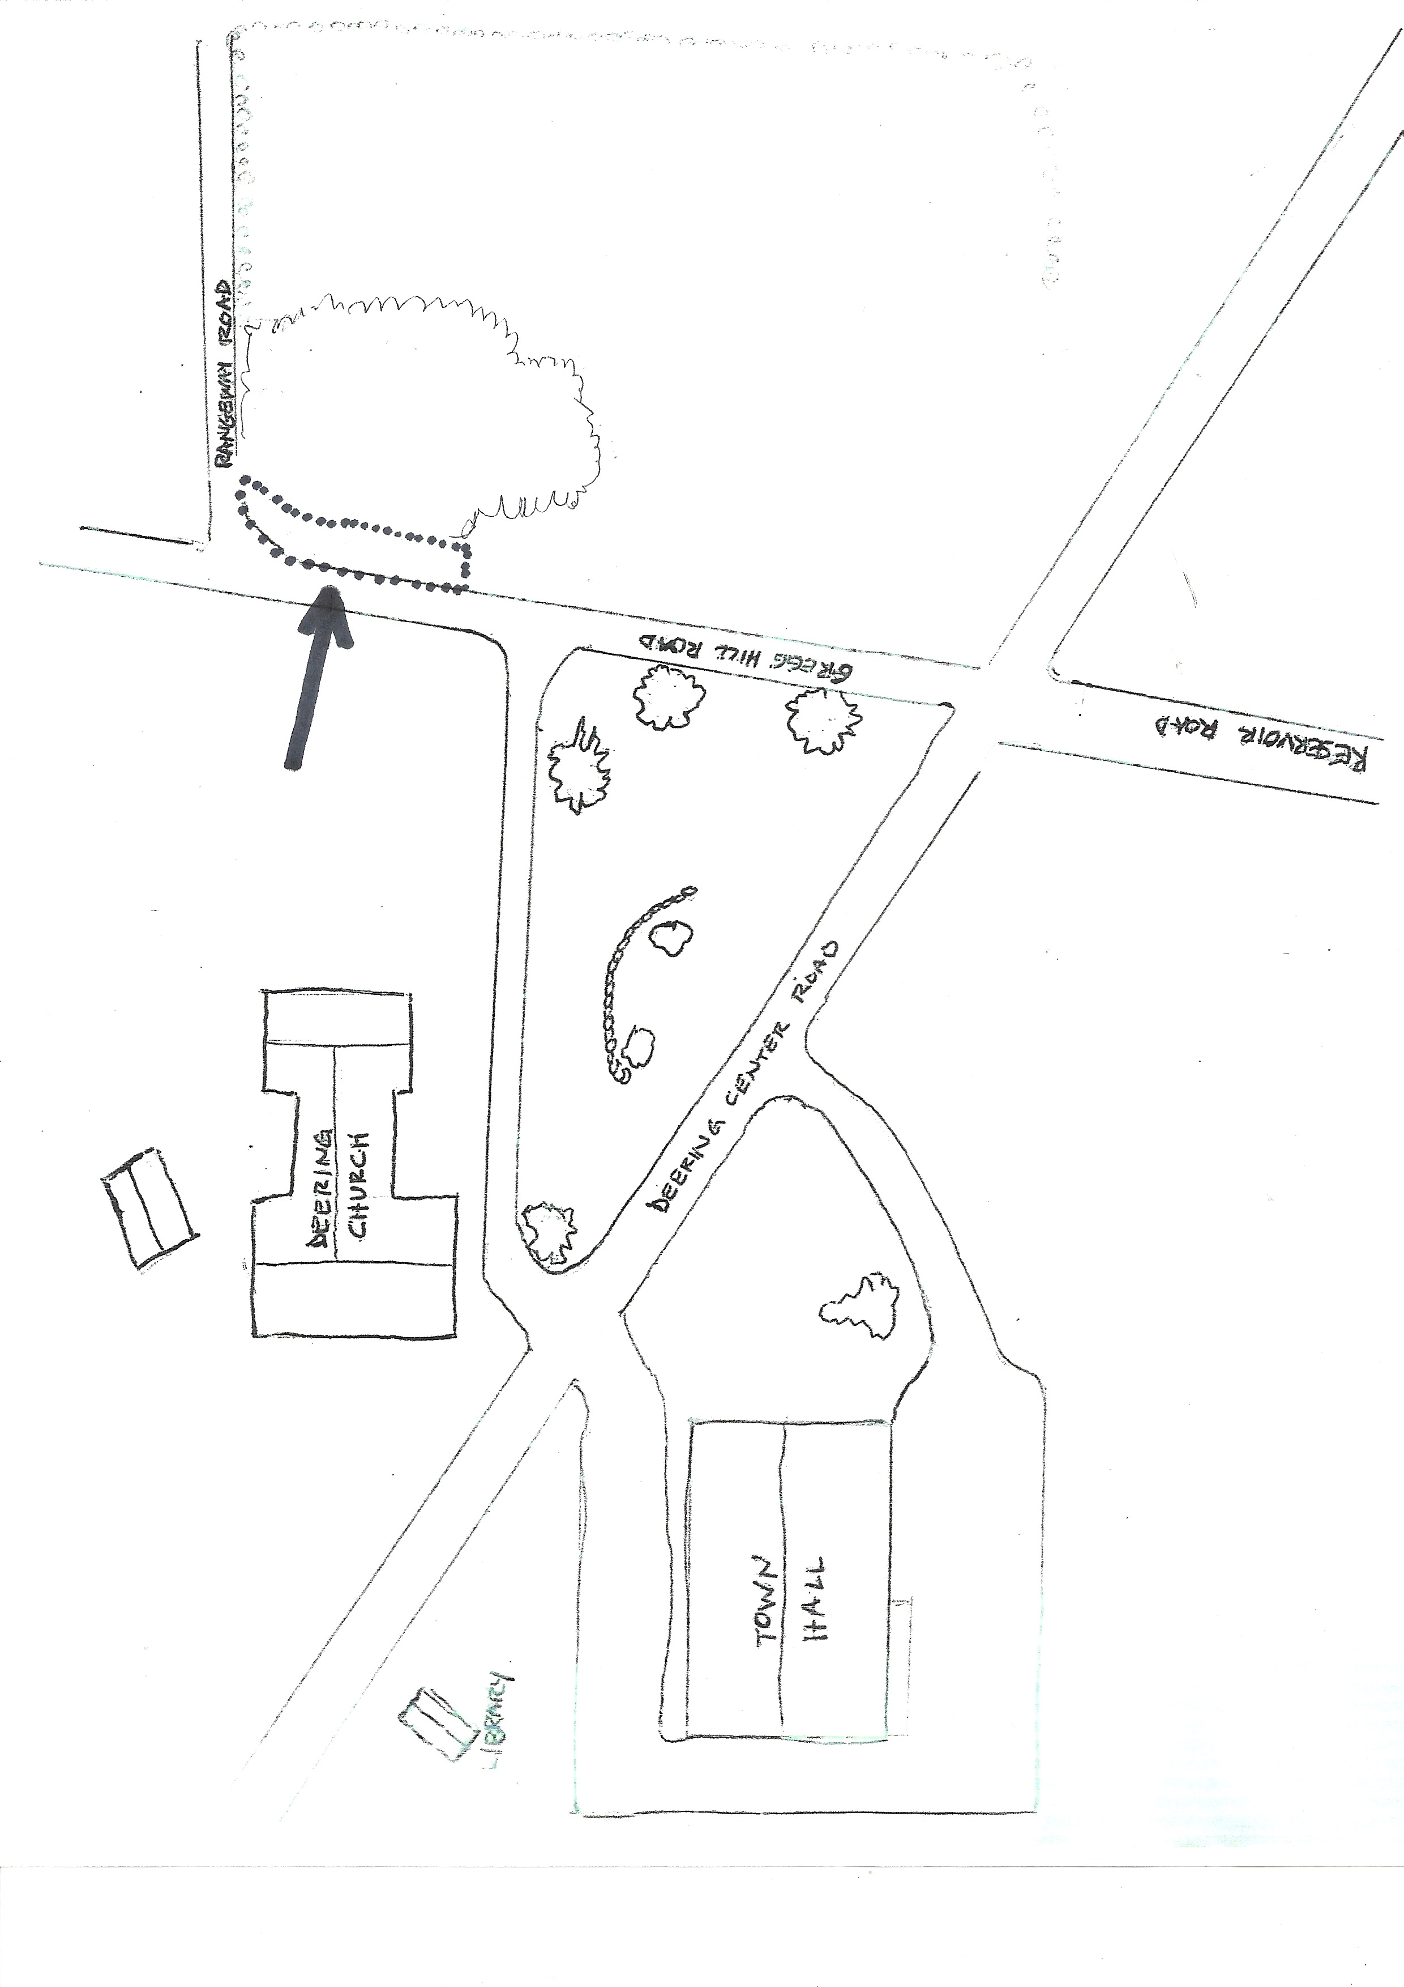
HOTEL LOT EXPANDED PARKING- up to 7 spaces for head in parking

Slide 12
HOTEL LOT EXPANDED PARKING AREA IDEA:
40’-50’ of 18” culvert pipe, 30 cu. yards Road Base, 15 cu. yards 2” minus
Est. Materials Cost $1000 - $1500 (using Town equipment to excavate and truck material)

Slide 13
Committee members looked at several town common structures of surrounding towns.
Many had Gazebos with a common theme...they are located on a flat landscape.
The Committee chose a rectangular shaped bandstand for several reasons:
Overall functionality
Ability to meld into the slope of the Hotel Lot
To showcase a granite foundation on the lower slope
It is in keeping with the architectural standard of the Town Center.

Slide 14
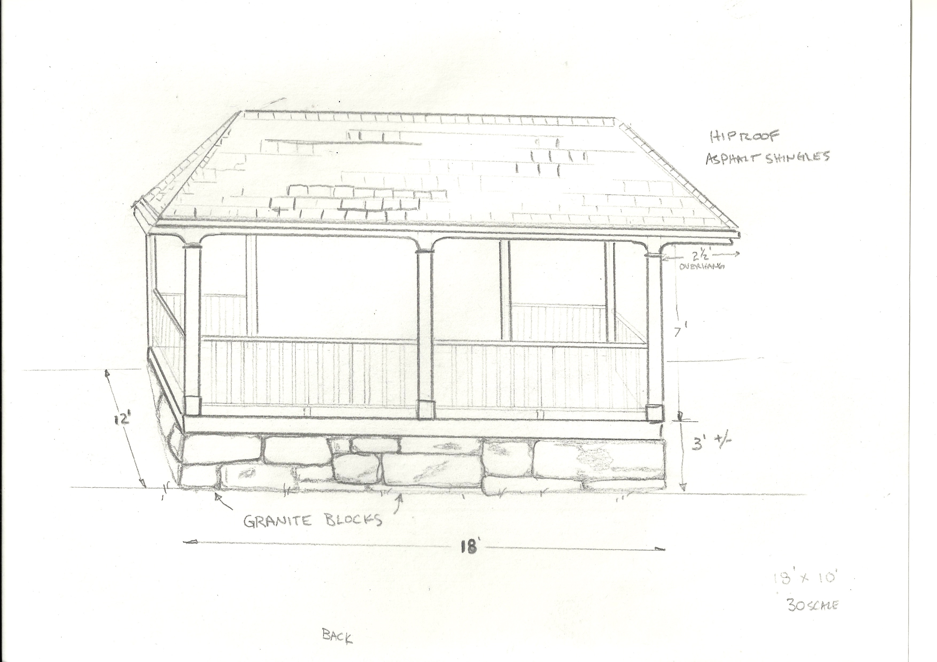
HOTEL LOT BANDSTAND
12-14’
18’
As viewed from Gregg Hill Road

Slide 15
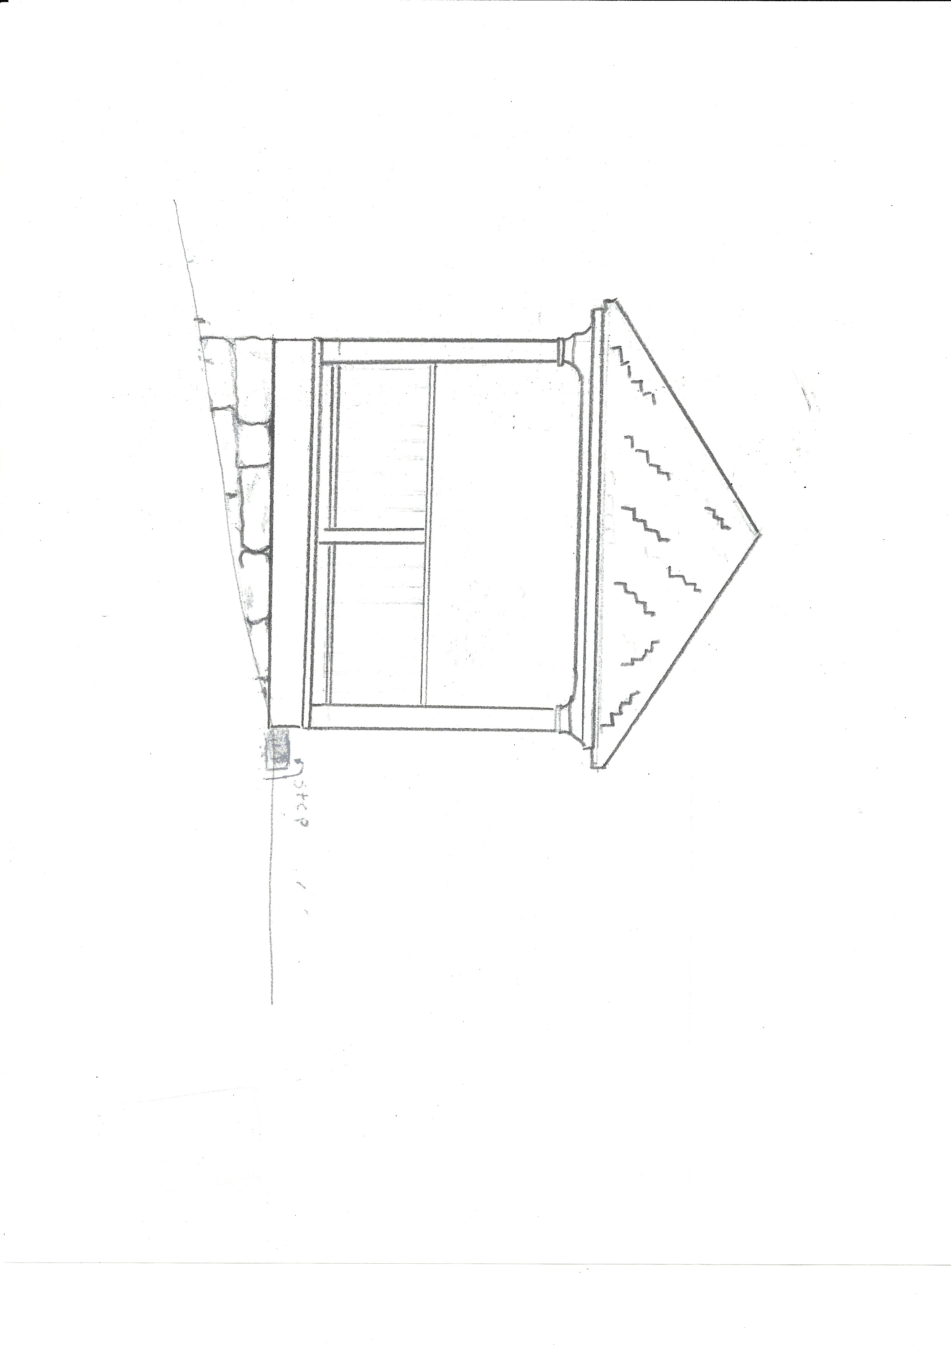
What better idea to promote community than to have the community build its own bandstand?
8’
12-14’
North
SIDE VIEW from Rte 149

Slide 16
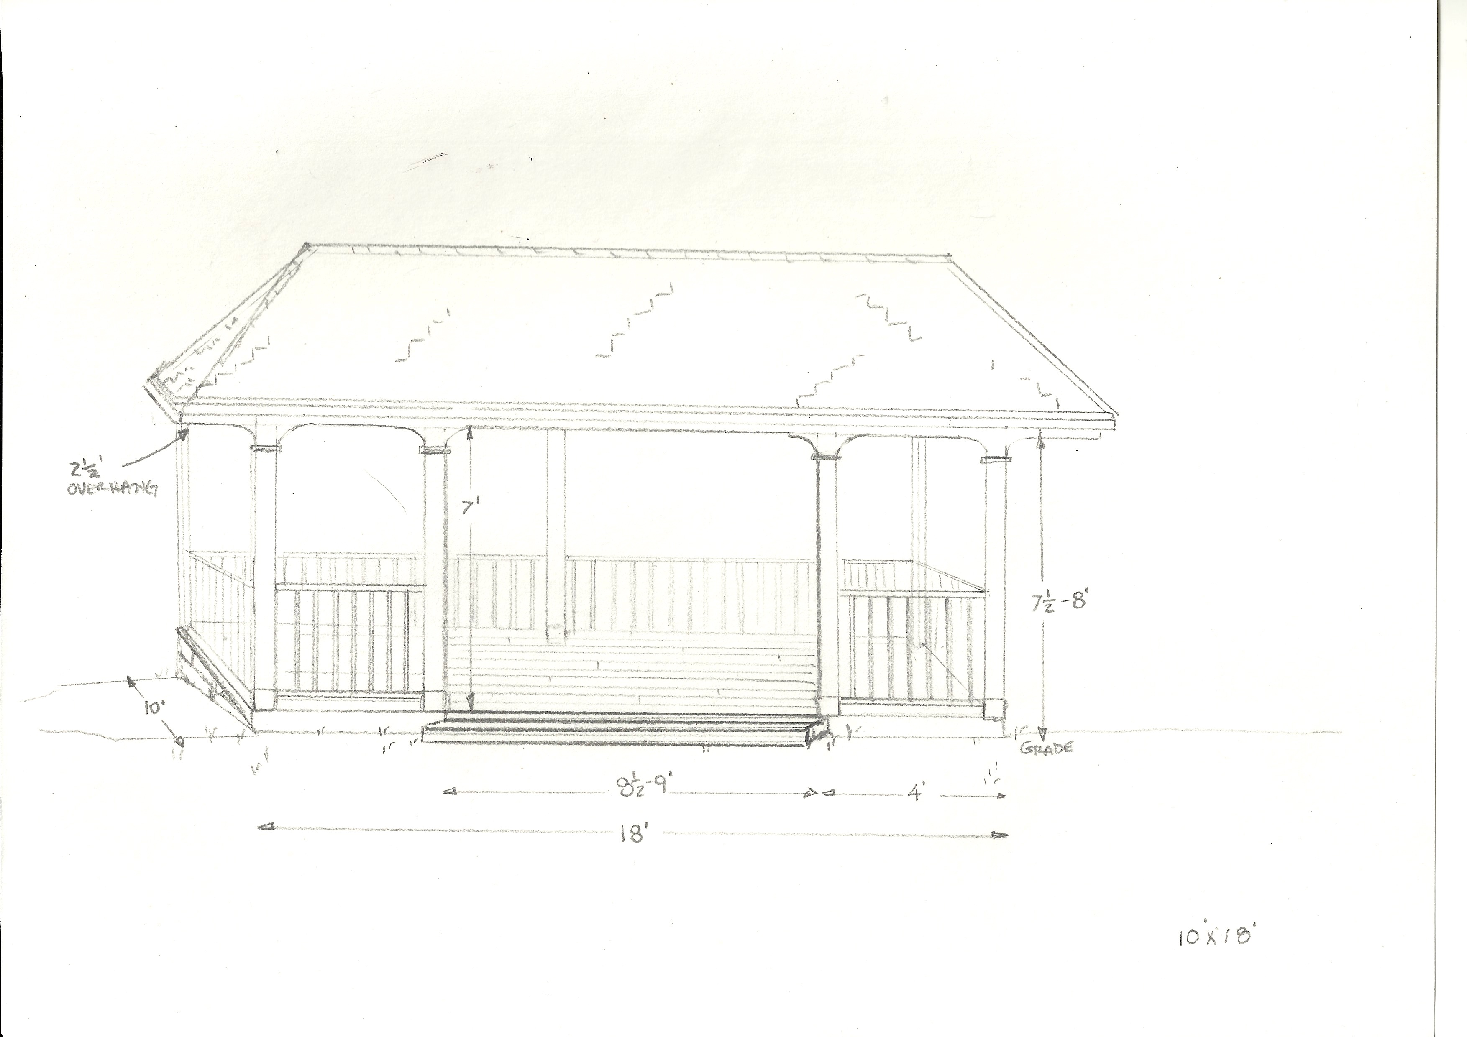
12-14’
18’
As viewed from the high end of the slope on the Hotel Lot

Slide 17
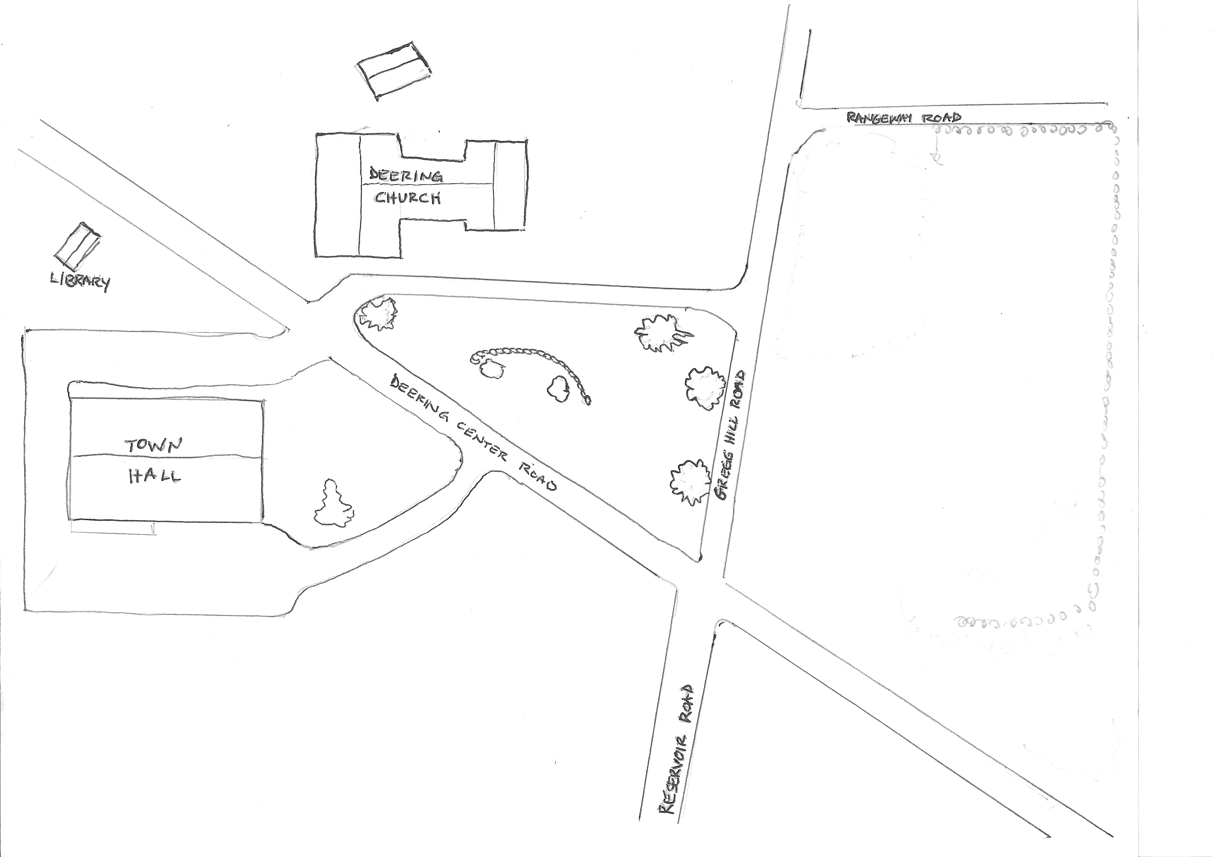
parking
Church
Belleview hotel site
Rough location of proposed bandstand
Town Hall

Slide 18
Bandstand Details
PVC or Composite decking and handrail
Pressure treated 6x6 posts and beams shrouded w/Versatex
Pressure treated 2x10 joists 12” O.C.
Manufactured wood trim
Spruce Rafters
Native White Pine ship lap roof sheathing
Asphalt shingles
Bandstand Cost Estimates
Excavation- Using Town Equipment…......$ 0
Footing Drainage- Crushed stone…………$ 350.00
Footing Base- Crushed Gravel……………..$ 250.00
Structure- Materials…………..……………..$14,500.00
Labor…………………………………………….$ 0
Est. Total Cost……………………....…………$15,100.00
Estimated total out to bid cost…………….$25,000.000

Slide 19
A HOTEL LOT WATER SOURCE
There are two existing sources of water near the Hotel lot.
One is a dug well that is located part way up Gregg Hill Road and was used by the Deering Community Church as potable water until around the year 2000 when the church drilled an artesian well.
The other dug well is located just over the stone wall at the Hotel lot’s southeast (highest) corner.
Since the Gregg Hill Road well is in direct line with the location of a proposed water spigot and has more head pressure, it is assumed that this water source might be more cost effective.
The committee recommends that a water line be connected and buried from the Gregg Hill well to a spot at the proposed parking area and that a frost hydrant with a tamper-proof lever be installed.

Slide 20
Hotel Lot Water Source Explanation
If the Hotel Lot is to be developed and incorporated into the Town Common, then the Town should plan for more garden areas, more community events that will require a water source and, eventually even a public toilet facility.
At the base level, a frost hydrant that is connected to the Gregg Hill Road dug well will allow for an outside, low maintenance, seasonal water source that doesn’t require electricity.
This water source could truly be a “community well” in every sense of the word by offering water from a public spigot to townspeople.
WATER SOURCE COST ESTIMATES
1” plastic water line and fittings………………………$ 250.00
Excavation…using Town equipment…………………$ 0
Backfill material….using town material……………..$ 0
Frost hydrant………………………………………………$ 150.00
Estimated Total Cost…………………………………….$ 400.00

Slide 21
To existing well
Proposed parking area
X
Proposed frost hydrant location

Slide 22
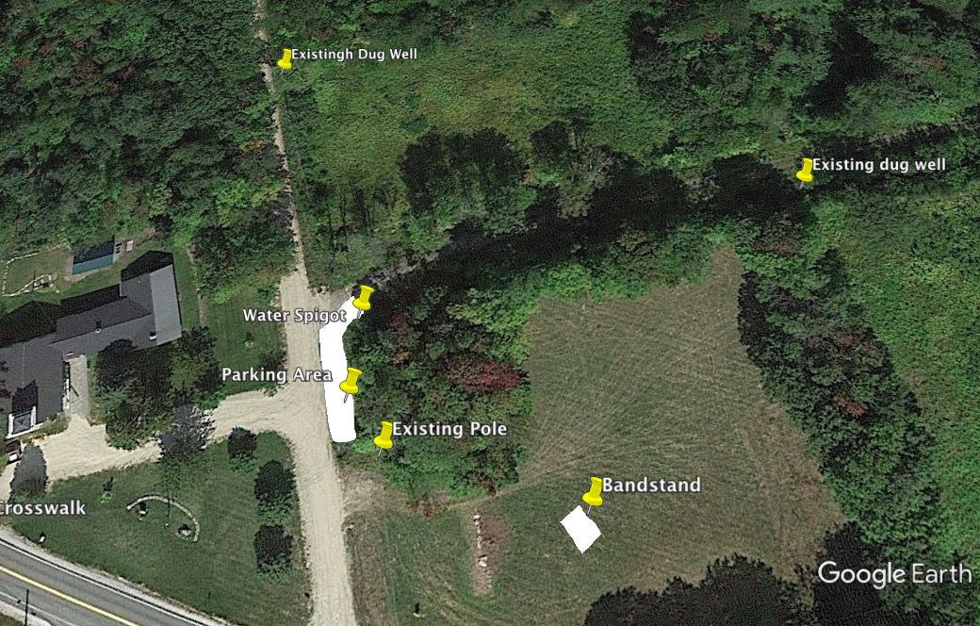

Slide 23
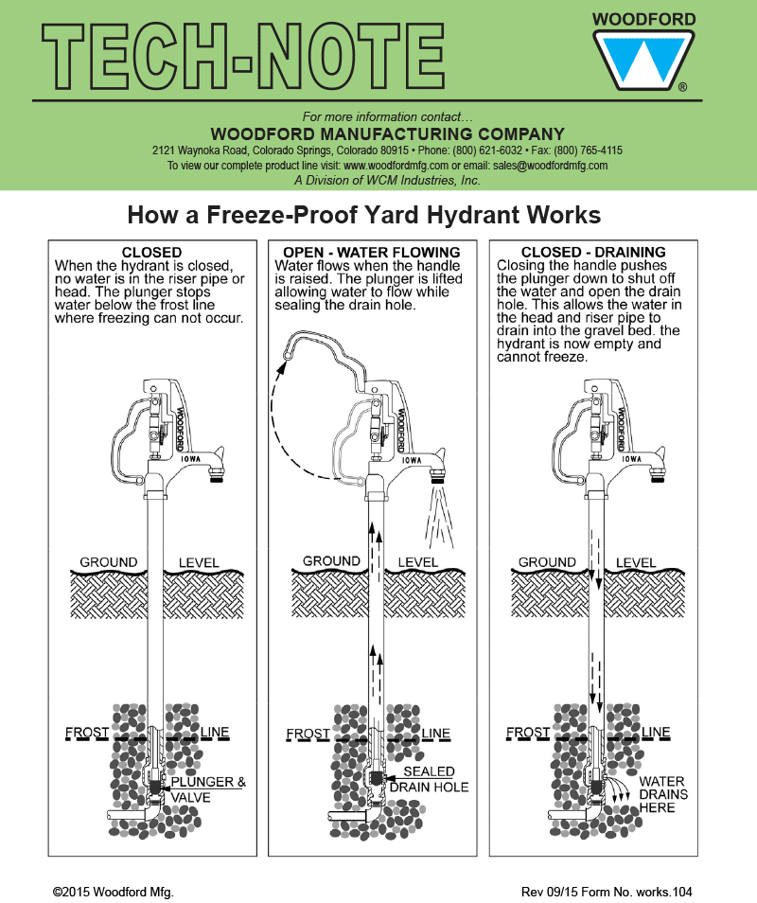

Slide 24
HOTEL LOT ELECTRICITY
Electric power would come from an existing pole located on the Hotel Lot property opposite the Deering Community Church lane.
Power would be connected via underground conduit to a pedestal located next to the proposed structure (bandstand or other) and end in a locked gang of outlets.
Eversource doesn’t charge for the first 100’ of service entrance cable. However, the distance to the proposed structure is roughly 175’ from the existing pole.
HOTEL LOT ELECTRICITY COST ESTIMATES
Eversource………………………………...…$1000 - $1,500
Conduit and other electrical supplies…...$ 800.00
Backfill material........................................$ 250 - $500
Electrician.................................................$ 500.00
Excavation...using Town Machinery.........$ 0
Estimated total Cost.................................$ 2550.00 - $2800.00

Slide 25
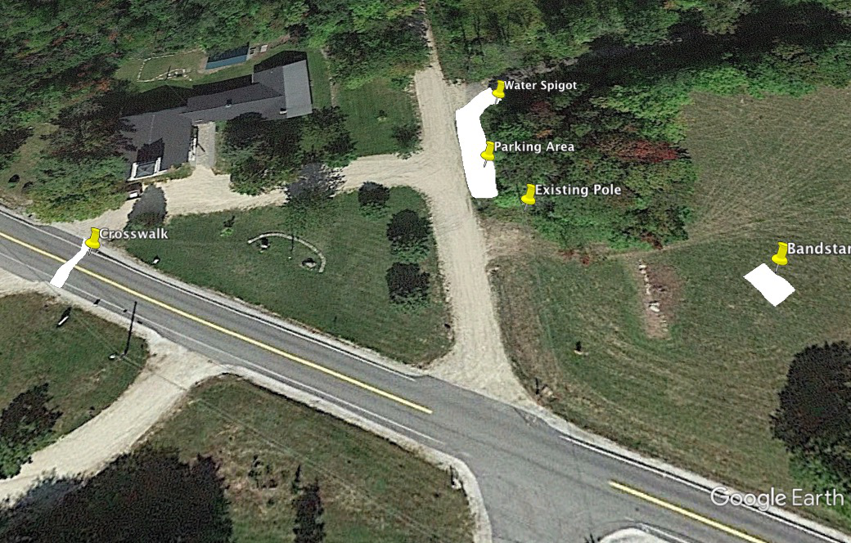

Slide 26
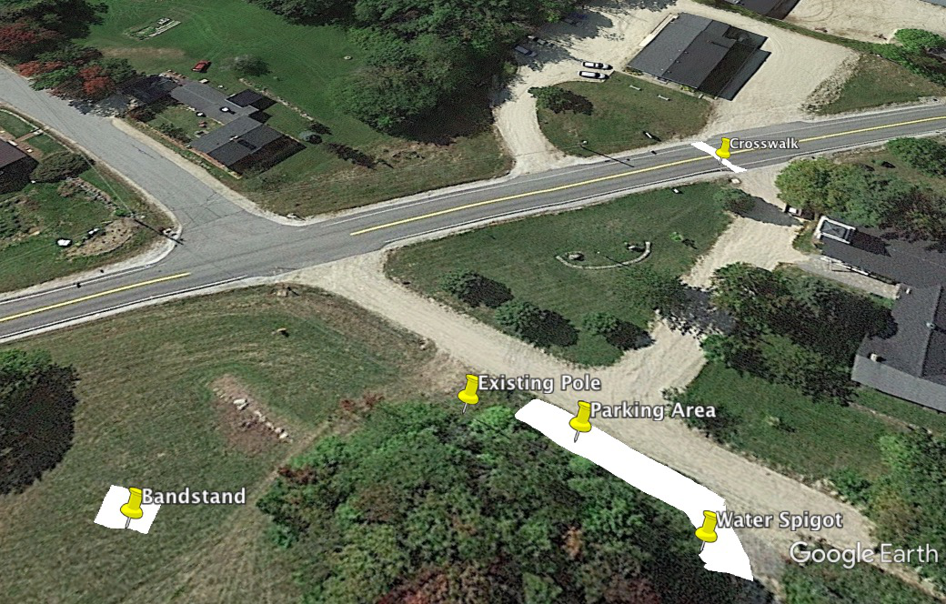

Slide 27
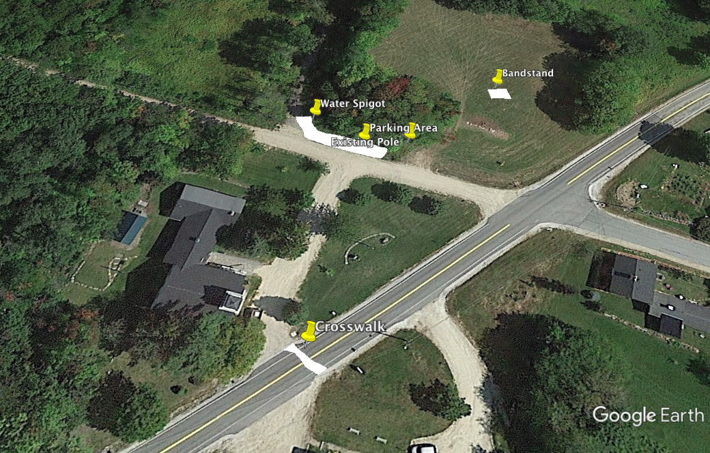

Slide 28
HOTEL LOT SUGGESTIONS FOR IMPROVEMENTS
Mow the field more regularly to eradicate the poison ivy and to maintain a neat appearance.
Create a shady space in the Belleview Hotel copse for picnic tables.
Create a pedestrian opening in the southern Hotel Lot stone wall that divides the lot and the abutting field (SPNHF Tom Rush conservation land) and invite people into that space to experience a Labyrinth or other natural creation that nurtures reflection.
Install a trailhead sign for Tom Rush Forest SPNHF trail at the Rangeway Road.
Offer several places (sun and shade) for kids to play, for people to sit and take in the view.
Create an archeological exhibit at the foundation of the Belleview Hotel site with signage about the hotel’s history.
Install large pieces of granite on the Lot at the top of the berm along Gregg Hill Road for people to sit on and to keep vehicles from going into the ditch.
Plant more shrubs and trees along Route 149 to create a natural safety barrier, improve aesthetics, a sound barrier,and to attract more songbirds.

Slide 29
TOWN COMMON SUGGESTIONS FOR IMPROVEMENT
A crosswalk connecting the Town Hall parking area (front walkway) and the Deering Community Church.
Tier the land between the Town Hall parking area and the Library with a retaining wall of natural granite to create a flat space for a patio or grassy gathering place.
Relocate the misc. granite benches and chestnut tree
to the area between the library and the parking area to form a designated “Citizen Remembrance/Memorial” space.
Install a concrete paver walkway at the front of the Town Hall that connects both parking areas and institute a remembrance paver program for citizens.
Encourage the formation of a Garden Club to maintain the plantings around the Town Common rather than rely on individuals.
Cull the Norway Maple in front of the Town Hall and replace with a non-invasive heritage tree.
Consider some exterior light posts around the town hall, in keeping with the existing church lighting, to connect the two main structures in the Town Center.

Slide 30
A CROSSWALK THAT CONNECTS ...
The Committee recommends pursuing the installation of a crosswalk, across Deering Center Road, that would connect the Town Hall and the Deering Community Church.
With the help of Deering Road Agent Brian Houghton and Deering Lake resident Howie Ives, the committee found the contact person from NH-DOT to talk to about a crosswalk across Rte 149. (Bureau of traffic 271-3734)
The Committee is confidant that there is adequate line of site (300’ each way) for this installation. There are other requirements as well, like a mandated raised textured surface -for the blind- that must be installed by the municipality on each end of the crosswalk.
At Issue is where to exactly locate the crosswalk to connect the Town Hall parking area and the exit lane of the church. The shortest route across (a perpendicular crossing) makes most sense in terms of safety and receiving NH-DOT support.
A discussion needs to take place between the Church folks and the Road Agent as some modifications to each side will need to happen for this crosswalk to be achieved.

Slide 31
What the committee still needs to develop:
Locating more safe play areas for children.
Hotel Lot- Locating places for picnic tables in the Belleview Hotel copse of trees.
Hotel Lot- Continue the stone wall and tree work.
Deering Church spotlight arborvitae- replacement with a shorter evergreen
Remembrance ideas to promote (i.e. plaques, pavers, light posts, benches, tiles, sculpture, gardens).
Locating seating areas throughout the Town Common lands.
Historic District Ordinance amendment.
A detailed survey of the Town Common and Master Plan
Archeological /Historical signage for Belleview Hotel site.
More public input about the committee’s ideas.

Slide 32
It is the consensus of this working group that a Town Common Committee could be a positive permanent fixture in the Town of Deering.
The Committee could keep an eye on all development on the Town Common- with guidance from the Deering Selectmen, Planning Board and the Deering Community Church.
The Town Common Committee would be guided by the Town of Deering Historical District Ordinance.
The Committee could help formulate and implement a protocol about citizen remembrance monuments and plantings and their placement.
The Committee could work with all local groups to stimulate usage of the Town Common and promote community events.

Slide 33
The members of the Town Common Committee wish to thank the Selectmen for the opportunity to serve.
The Committee hopes that these initial ideas that have been presented will serve as a starting point that will, eventually, connect all of the physical elements of Deering’s beautiful Town Common.
We look forward to the prospect of presenting more realistic ideas that will promote a unified community vision about the common land in the town’s center.
END

